Slide 1

Airline Management System
TEAM: MENTOR:
A Pasupathi Nadh Bragadeesan Srinivasan
Pichika Anil Naga Sai
Paul Indranil
Rama Krishna Bathina
Takkellapati Anilkumar

Slide 2
System Requirements
Search for flights function is used for customer is able to search for one-way, round-trip and multiple destination flights by choosing specific dates and destinations.
Book flights function allows customer to book flights by choosing ticket types and processing online payment.
Request cancellation function indicates that customer can request the cancellation of the reserved ticket.
Modify flight details Using this functionality administrator can modify the details of the existing flights.
Remove flights With the help of this function administrator removes the flights from the system that are cancelled for whatever reason.
cancellation requests This functionality allows administrator to overview the cancellation requests of customers,and approve or reject them.
See booking details This functionality enables administrator to view the customers’ booking details.
Bank Function is used for receiving payments.

Slide 3
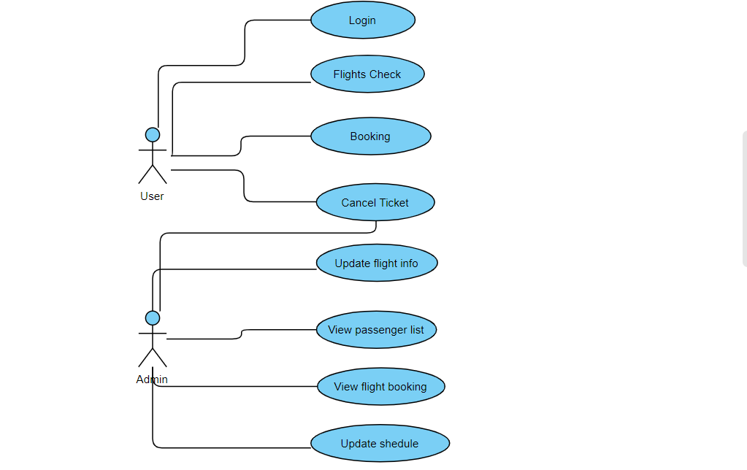
Use case Diagram

Slide 4
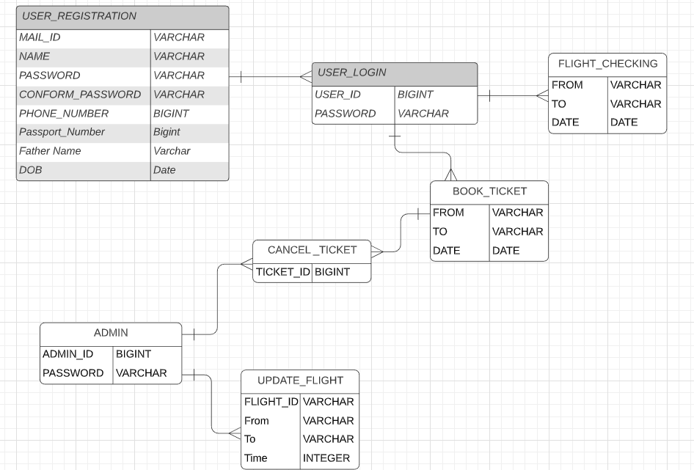
DATABASE DESIGN

Slide 5
Software Requirements
Operating System : Windows
Technology’s : Html ,Angular7 ,Bootstrap, Spring boot , Mysql
IDE : STS ,Visual Studio

Slide 6
Thank you

